Slide 1
Neonatal mortality: how to reduce it?
Dr Giulia Scarpa, Institute of Tropical Medicine, Antwerp
Thanks to Dr Sarah Moxon for the slides (from SRH course, ITM, 2024)

Slide 2
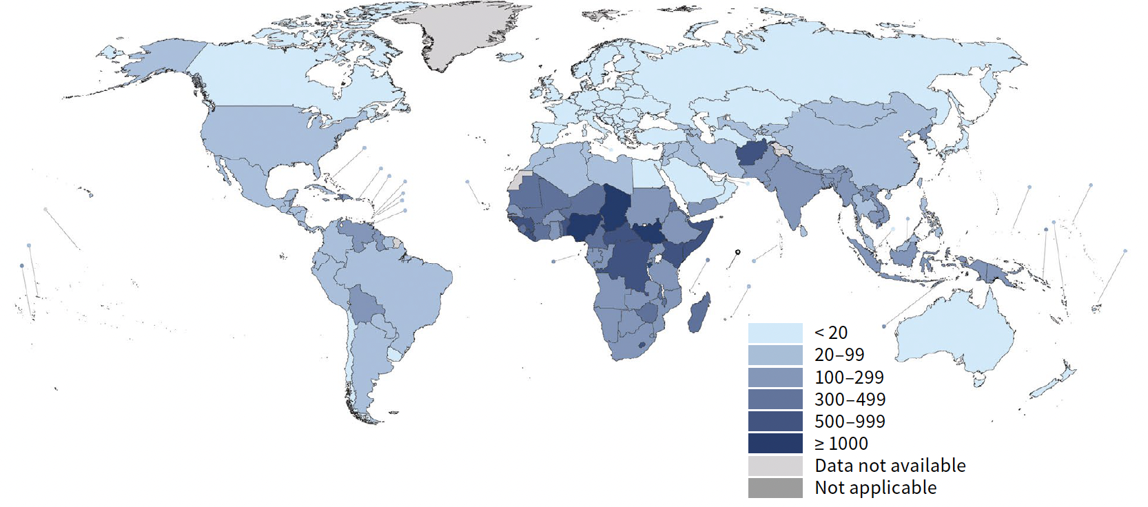





Maternal mortality ratio (MMR) estimates, by country, 2020
WHO MMR estimates 2000-2020,

Slide 3
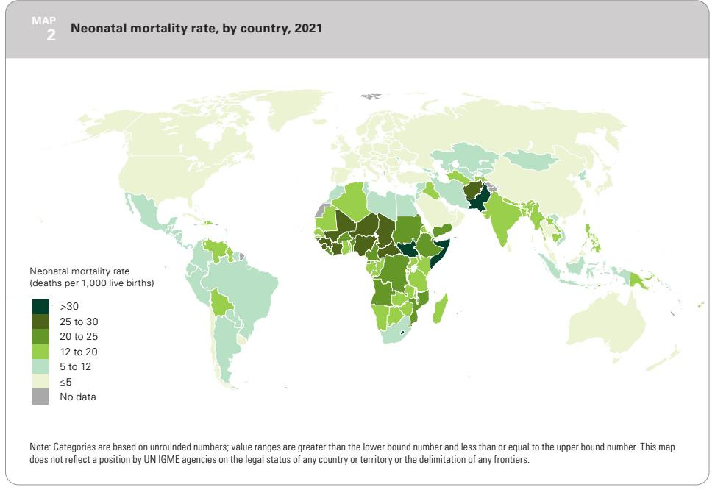
https://data.unicef.org/resources/levels-and-trends-in-child-mortality/

Slide 4
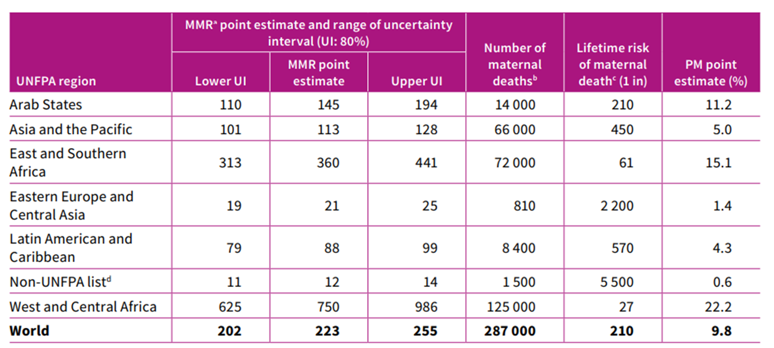
Maternal Mortality Estimate
Trends in maternal mortality 2000 to 2020: estimates by WHO, UNICEF, UNFPA, World Bank Group and
UNDESA/Population Division. Geneva: World Health Organization; 2023. Licence: CC BY-NC-SA 3.0 IGO.

Slide 5
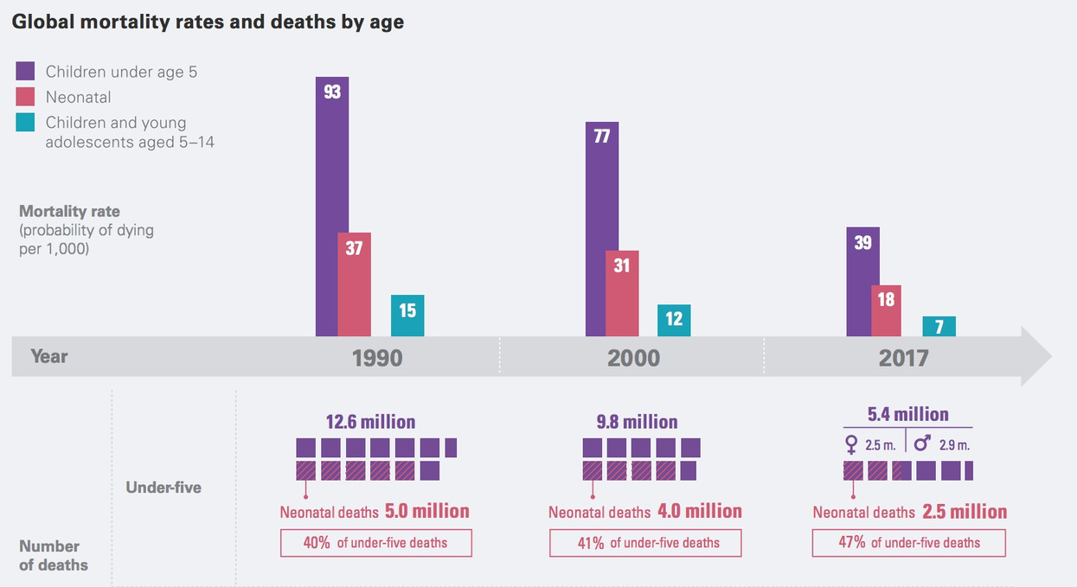
In 2021 ~2.3 million newborn deaths ….+ ~2 million stillbirths = ~ 4.3 million
https://childmortality.org/wp-content/uploads/2021/12/UNICEF-2021-Child-Mortality-Report.pdf Hug et al (2021) Global, regional, and national estimates and trends in stillibrthsfrom 2000-2009: a systematic assessment.

Slide 6
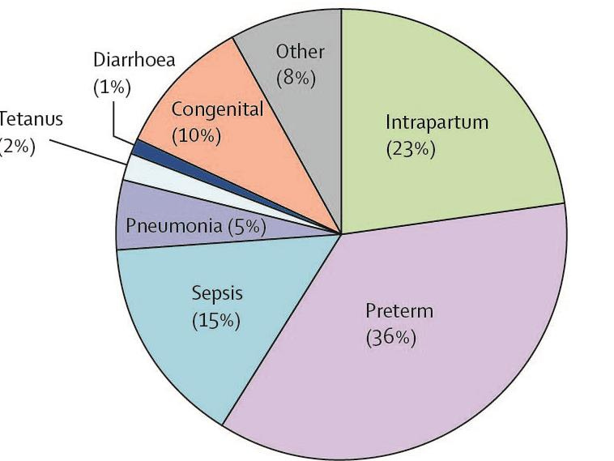
Causes of death

Slide 7
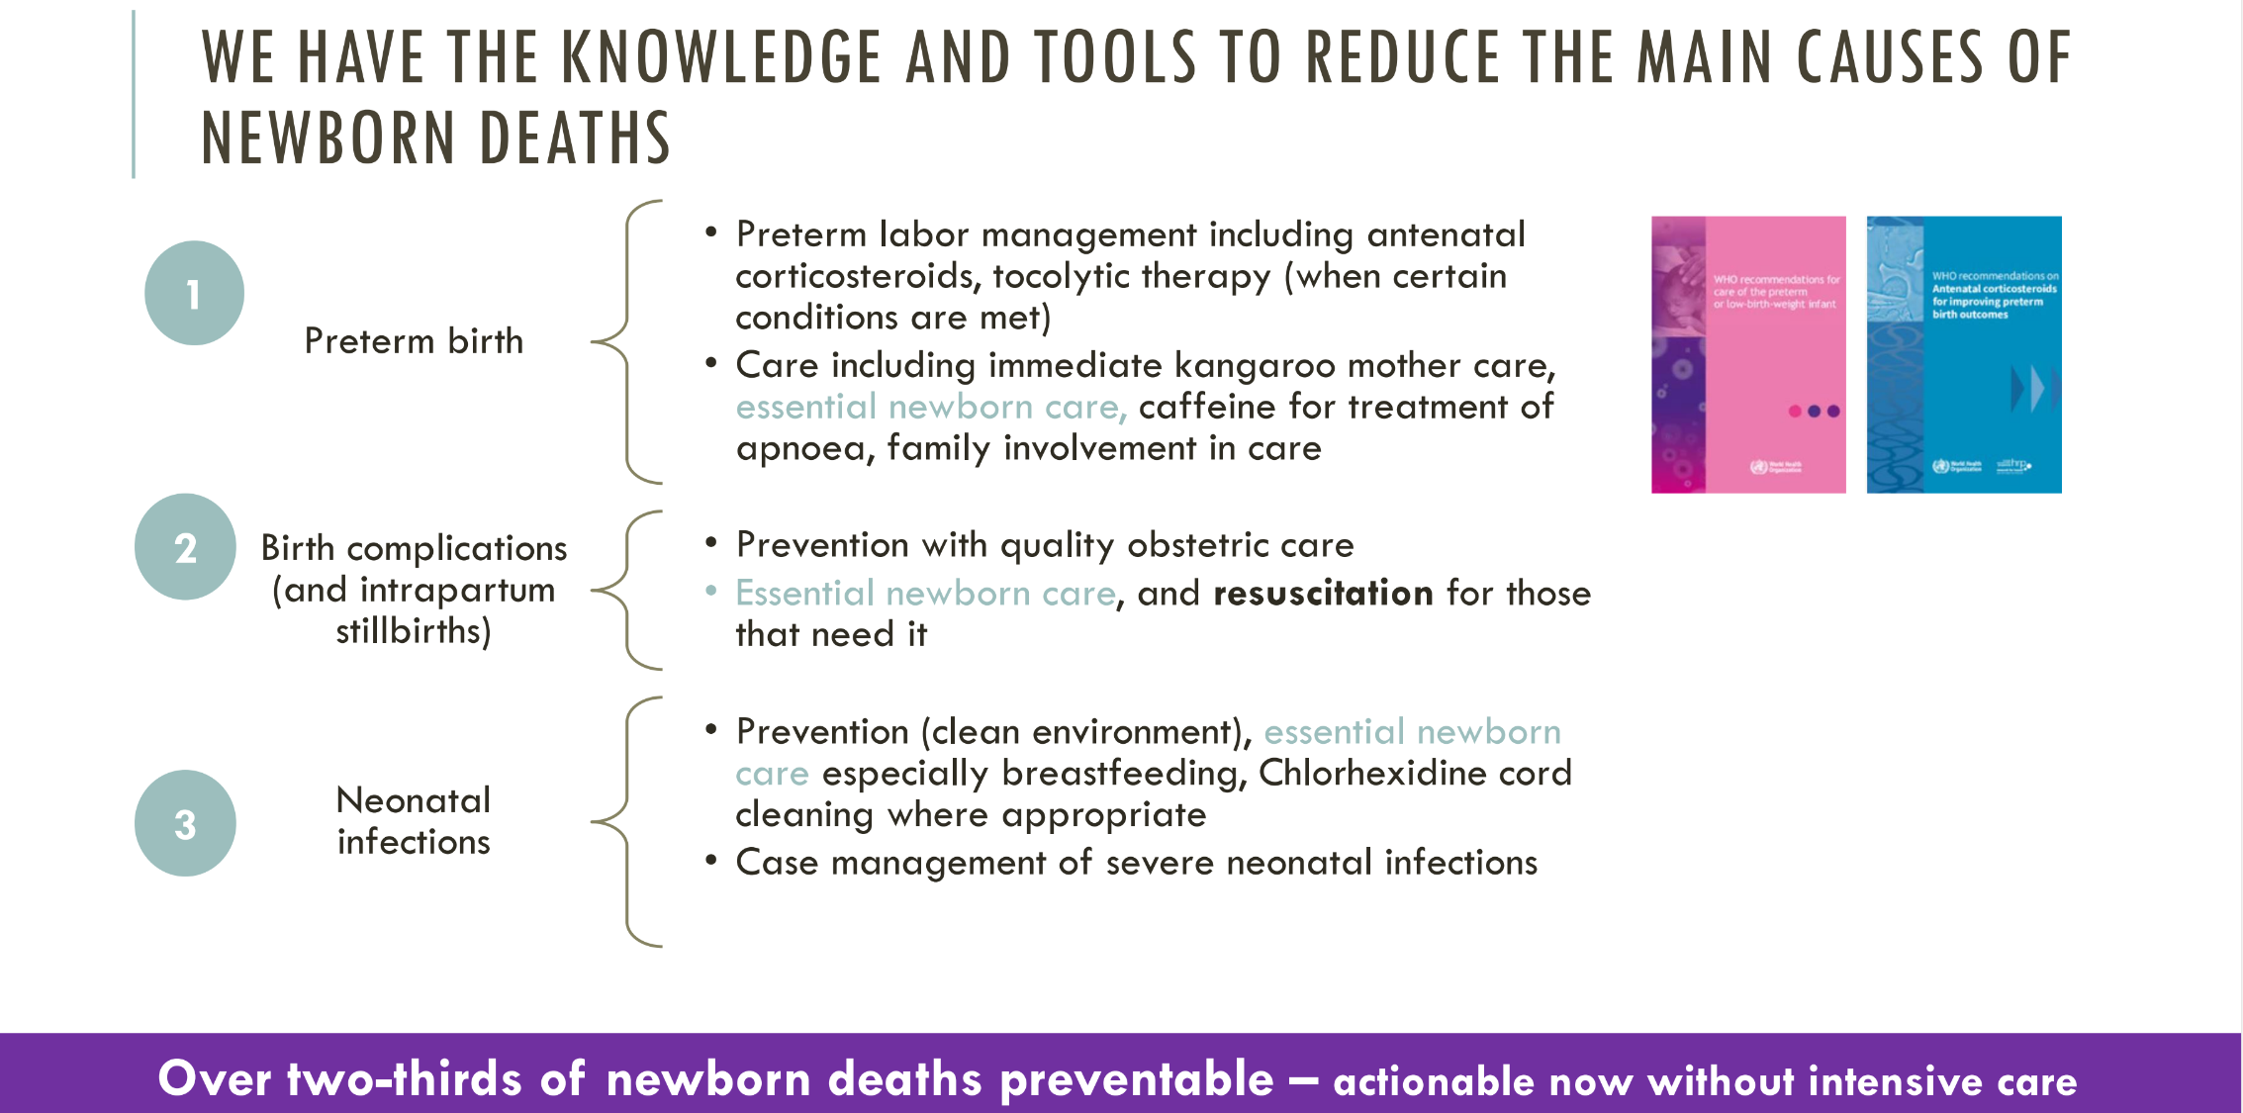

Slide 8
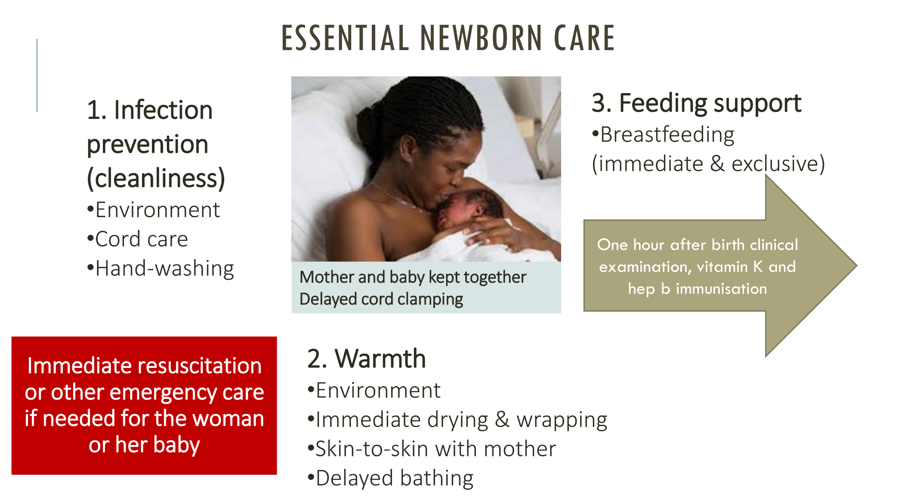

Slide 9
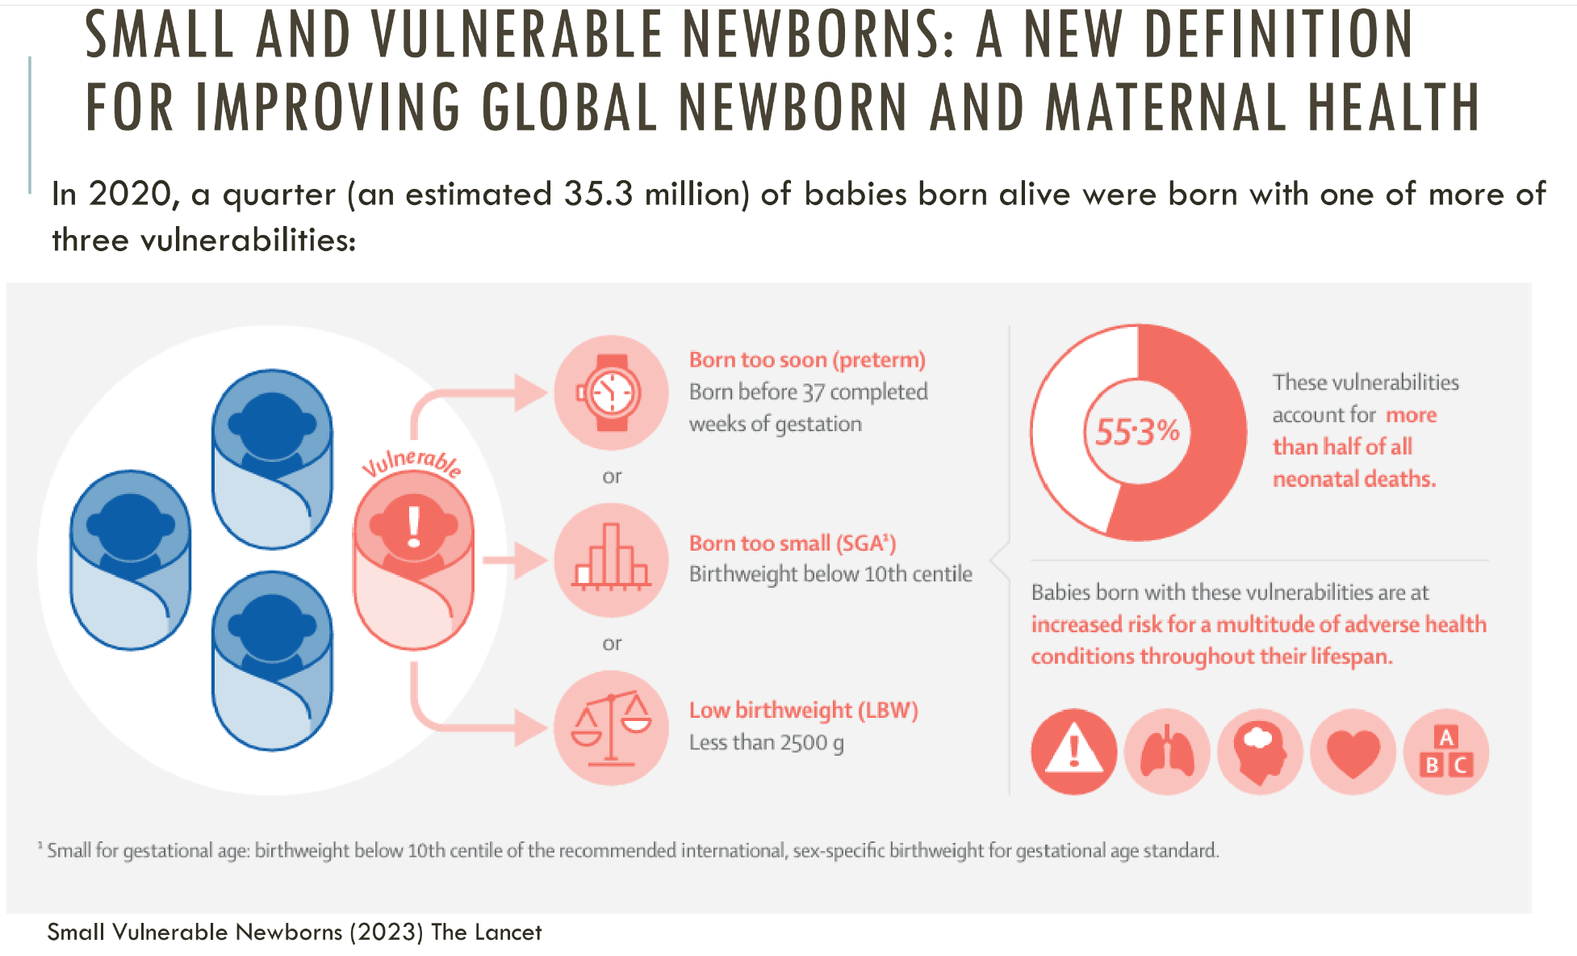

Slide 10
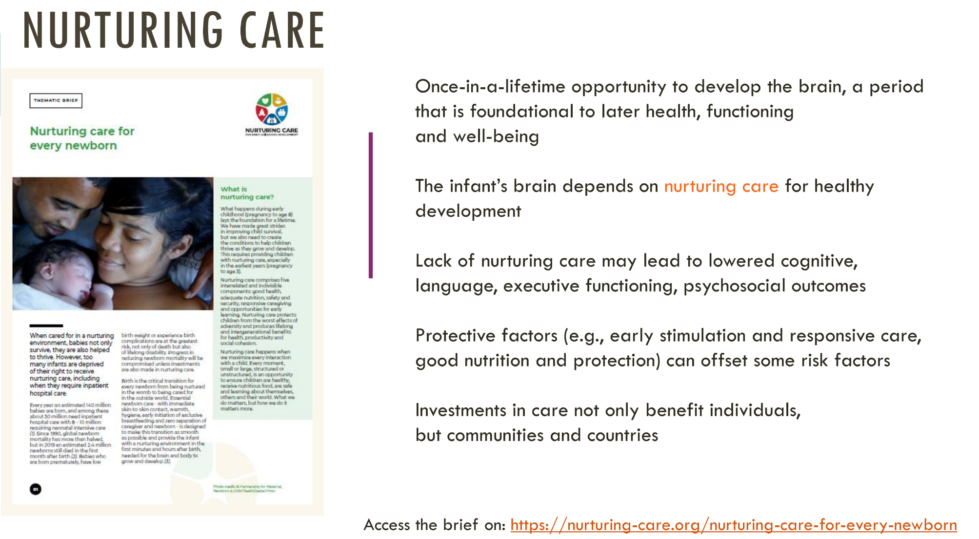

Slide 11
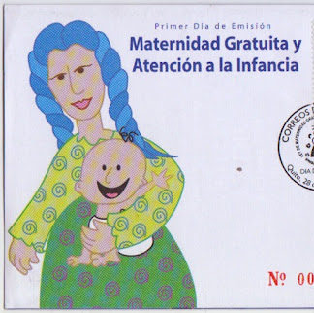
Community-Centered Maternal Healthcare
The Ecuador Experience in Reducing and Preventing Maternal and Neonatal Mortality
Dr Ana Lucia Martinez-Abarca, Institute of Tropical Medicine, Antwerp
Image: Correos del Ecuador

Slide 12
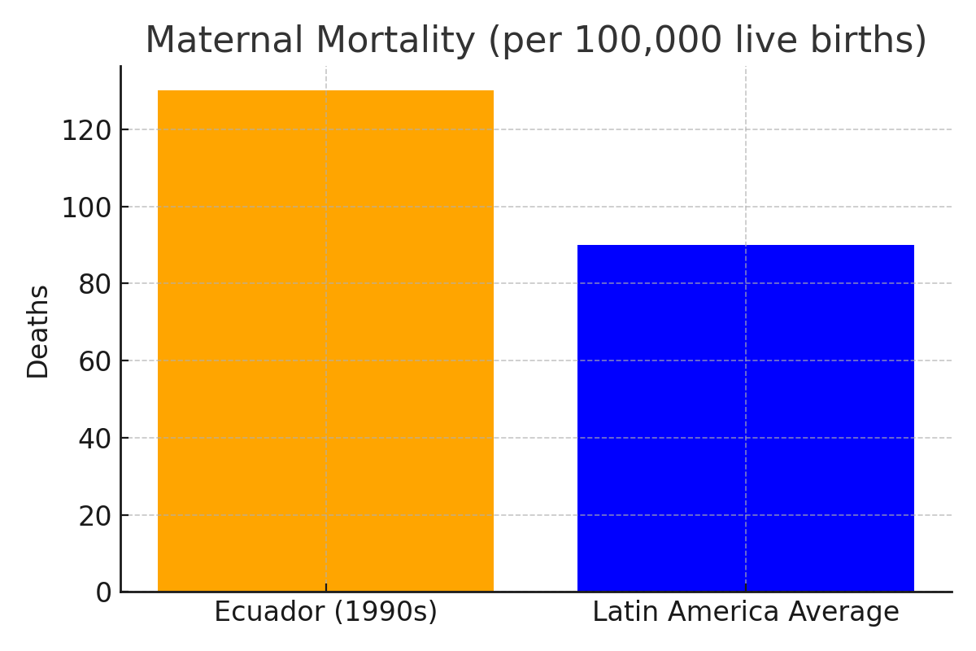
Maternal and Neonatal Mortality in Ecuador Before the Law
High Mortality Rates:
Barriers to Healthcare Access

Slide 13
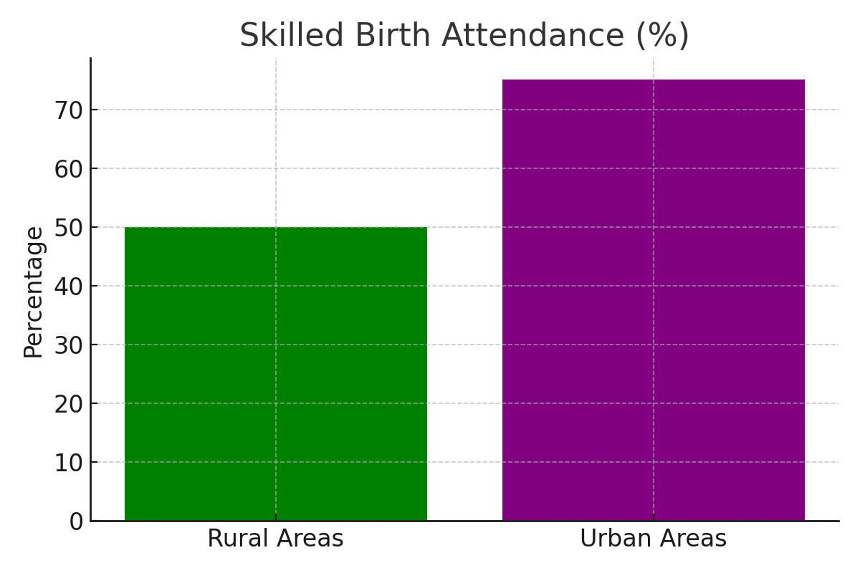
Cultural and Structural Gaps:
Mismatch between healthcare practices and traditional birthing customs.
Lack of culturally sensitive care discouraged indigenous women from utilizing services.

Slide 14
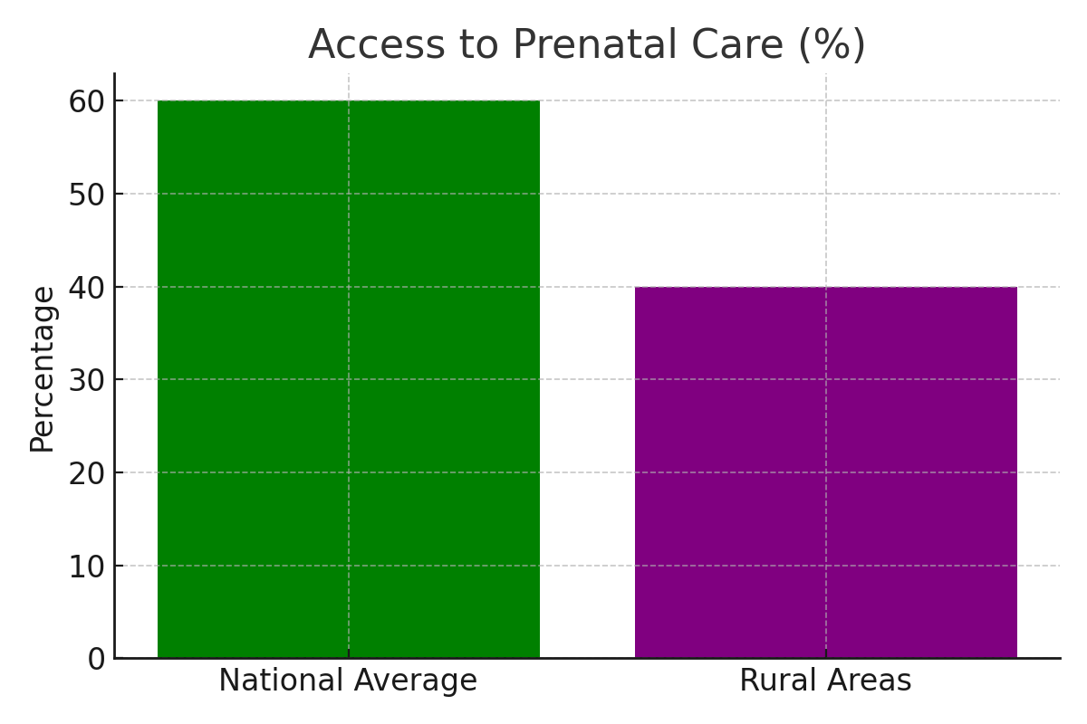
Systemic Challenges:
Inadequate health infrastructure and limited trained personnel in remote areas.
Minimal community engagement in health service planning and delivery.

Slide 15

Community-Centered Strategies
Encouraging active participation of women and communities.
Cultural Sensitivity
Local Leadership
Image: https://ontariohealthathome.ca/community-engagement-framework/

Slide 16

Strategy 1 - 'Comités de Usuarias' (User Committees)
Ensure women’s voices are heard in healthcare planning and evaluation.
Community feedback sessions to assess service quality.
Advocacy for maternal health rights and resources.
Improved accountability and responsiveness in health services.

Slide 17
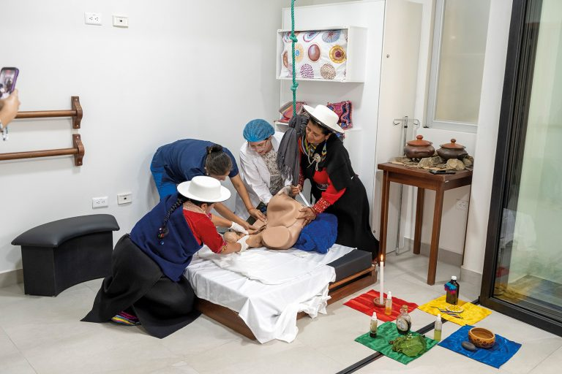
Strategy 2 - 'Salas de Parto Culturalmente Adecuado' (Culturally Appropriate Birthing Rooms)
Create respectful, inclusive spaces for childbirth, addressing the needs of diverse ethnic and cultural group
Integration of traditional midwives and family support during delivery.
Enhanced accessibility and trust in healthcare services for historically underserved populations.
Improved maternal and neonatal health outcomes through culturally competent care.
https://culturacientifica.utpl.edu.ec/la-utpl-inaugura-el-primer-laboratorio-de-parto-intercultural-del-pais/

Slide 18

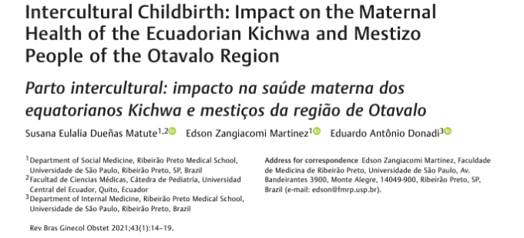
https://pmc.ncbi.nlm.nih.gov/articles/PMC10183941/

Slide 19
Thank you for your attention ☺

